Slide 1
Extracting Search-Focused Key N-Grams for Relevance Ranking in Web Search
Date: 2012/11/29
Author: Chen Wang, Keping Bi, Yunhua Hu, Hang Li,
Guihong Cao
Source: WSDM’12
Advisor: Jia-ling, Koh
Speaker: Shun-Chen, Cheng

Slide 2
Outline
Introduction
Key N-Gram Extraction
Pre-Processing
Training Data Generation
N-Gram Feature Generation
Key N-Gram Extraction
Relevance Ranking
Relevance Ranking Features Generation
Ranking Model Learning and Prediction
Experiment
Studies on Key N-Gram Extraction
Studies on Relevance Ranking
Conclusion

Slide 3
Introduction
Head page v.s tail page
The improvement of searching tail page increases satisfaction of user with search engine.
head page apply to tail page
N-Gram
n successive words within a short text separated by punctuation symbols and special HTML tags.
e.g.
<h1>Experimental Result</h1>
Short text: Experimental Result
Not all tag means separation
<font color="red">significant</font>
‘Significant ’ is not a source of N-Gram

Slide 4
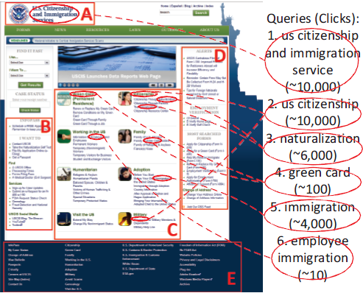
Introduction
Why they looks same in their appearance , however the one popular and the other unpopular?

Slide 5
Introduction
Framework of this approach

Slide 6
Outline
Introduction
Key N-Gram Extraction
Pre-Processing
Training Data Generation
N-Gram Feature Generation
Key N-Gram Extraction
Relevance Ranking
Relevance Ranking Features Generation
Ranking Model Learning and Prediction
Experiment
Studies on Key N-Gram Extraction
Studies on Relevance Ranking
Conclusion

Slide 7
Pre-processing
HTML => sequence of tags/words
Words => lower case
Stop words are deleted
ftp://ftp.cs.cornell.edu/pub/smart/english.stop

Slide 8
Training Data Generation
e.g.:
Web content: ABDC Query: ABC
unigram: A,B,D,C unigram: A,B,C
bigram: AB,BD,DC bigram: AB,BC
trigram: ABD,BDC trigram: ABC
A , B, C > D ，AB > DC ，AB > BD
Web content
Query

Slide 9
N-Gram Feature Generation
Frequency Features
(each includes Original and Normalized )
Frequency in Fields:
URL、page title 、meta-keyword、meta-description
Frequency within Structure Tags:
<h1>～<h6>、<table>、<li>、<dd>
Frequency within Highlight Tags:
<a>、<b>、<i>、<em>、<strong>
Frequency within Attributes of Tags:
Specifically, title, alt, href and src tag attributes are used.
Frequencies in Other Contexts:
<h1>～<h6>、 meta-data、page body、whole HTML file

Slide 10
N-Gram Feature Generation
Appearance Features
Position: position when it first appears in the title, paragraph and
document.
Coverage: The coverage of an n-gram in the title or a header
e.g., whether an n-gram covers more than 50% of the title.
Distribution: entropy of the n-gram across the parts

Slide 11
Key N-Gram Extraction
Learning to rank
RankSVM
Top K n-grams = Key N-Gram
X: n-gram
W: features of a n-gram
C : variable
Ɛij : slack variable

Slide 12
Outline
Introduction
Key N-Gram Extraction
Pre-Processing
Training Data Generation
N-Gram Feature Generation
Key N-Gram Extraction
Relevance Ranking
Relevance Ranking Features Generation
Ranking Model Learning and Prediction
Experiment
Studies on Key N-Gram Extraction
Studies on Relevance Ranking
Conclusion

Slide 13
Relevance Ranking Features Generation
Query-document matching feature
Unigram/Bigram/Trigram BM25
Original/Normalized PerfectMatch
Number of exact matches between query and text in the stream
Original/Normalized OrderedMatch
Number of continuous words in the stream which can be matched
with the words in the query in the same order
Original/Normalized PartiallyMatch
Number of continuous words in the stream which are all contained
in the query
Original/Normalized QueryWordFound
Number of words in the query which are also in the stream
PageRank

Slide 14
BM25
TFt(x)
q: query
d: key n-grams
t: type of n-grams
x: value of n-gram
k1,k3,b: parameter
avgft: average number of type t

Slide 15
PageRank
d: damping factor (0,1)
PR(pj;t): the pagerank of Webj while iteration t
L(pj): the number of Webj’s out-link
M(pi): the in-link of Webi
N: number of Web

Slide 16
PageRank
e.g.
C
Suppose d=0.6
A B C D E F G H
D
ABCDEFGH
0 1/1 0 1/1 0 0 1/1 1/1
B
0 0 0 0 0 0 0 0
G
1/3 0 0 0 0 0 0 0
F
A
0 0 0 0 0 0 0 0
1/3 0 0 0 0 0 0 0
E
H
1/3 0 0 0 0 0 0 0
0 0 1/1 0 0 0 0 0
A B C D E F G H
0 0 0 0 1/1 1/1 0 0
ABCDEFGH
0 1/1 0 1/1 0 0 1/1 1/1
1/8
1/8
1/8
1/8
1/8
1/8
1/8
1/8
0 0 0 0 0 0 0 0
1/3 0 0 0 0 0 0 0
First iteration
0 0 0 0 0 0 0 0
$\frac{1−0.6}{8}$
+
0.6
1/3 0 0 0 0 0 0 0
1/3 0 0 0 0 0 0 0
0 0 1/1 0 0 0 0 0
0 0 0 0 1/1 1/1 0 0
iterate until converge

Slide 17
Ranking Model Learning and Prediction
new query ,retrieved web pages
query-document matching features
ranking scores
Rank web pages
use RankSVM again

Slide 18
Outline
Introduction
Key N-Gram Extraction
Pre-Processing
Training Data Generation
N-Gram Feature Generation
Key N-Gram Extraction
Relevance Ranking
Relevance Ranking Features Generation
Ranking Model Learning and Prediction
Experiment
Studies on Key N-Gram Extraction
Studies on Relevance Ranking
Conclusion

Slide 19
Experiment
Dataset
Training of key n-gram extraction
one large search log dataset from a commercial search engine over
course of one year
clickmin=2 Ntrain=2000 querymin=5 (best setting)

Slide 20
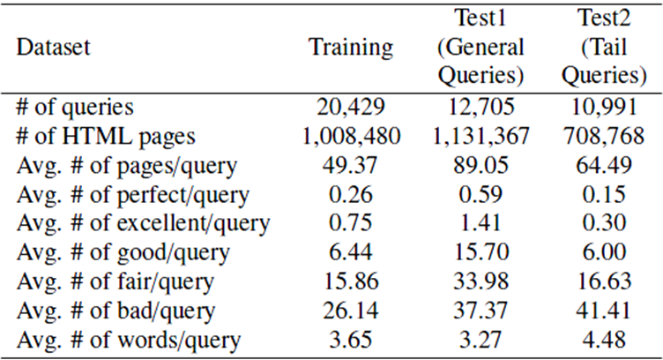
Experiment
Dataset
Relevance ranking
three large-scale relevance ranking
K : number of top k n-grams selected
n : number of words in n-grams ex: unigram,bigram..
Best setting: K=20 ，n=3

Slide 21
Experiment
Evaluation measure : MAP and NDCG
NDCG@n : only compare top n
DCG :
Web1 | Web2 | Web3 | Web4 | Web5
3 | 2 | 3 | 0 | 1
IDCG :
Web1 | Web2 | Web3 | Web4 | Web5
3 | 3 | 2 | 1 | 0
i | Reli | Log(i+1) | $$\frac{reli}{log(i+1)}$$
1 | 3 | 1 | 3
2 | 2 | 1.58 | 1.266
3 | 3 | 2 | 1.5
4 | 0 | 2.32 | 0
5 | 1 | 2.59 | 0.386
NDCG@5 = $\frac{3+1.266+1.5+0+0.386}{3+1.899+1+0.431+0}$
= $\frac{6.152}{6.33}$ = 0.972

Slide 22
Relevance ranking performance can be significantly enhanced by adding extracted key n-grams into the ranking model

Slide 23
our approach can be more effective on tail queries than general
queries.

Slide 24
Outline
Introduction
Key N-Gram Extraction
Pre-Processing
Training Data Generation
N-Gram Feature Generation
Key N-Gram Extraction
Relevance Ranking
Relevance Ranking Features Generation
Ranking Model Learning and Prediction
Experiment
Studies on Key N-Gram Extraction
Studies on Relevance Ranking
Conclusion

Slide 25
it is hard to detect key n-grams in an absolute manner, but easy to judge whether one n-gram is more important than another.

Slide 26
the use of search log data is adequate for the accurate extraction of key n-grams.
Cost is definitely less than human labeled

Slide 27
The performance may increase slightly as more training data becomes available.

Slide 28
Outline
Introduction
Key N-Gram Extraction
Pre-Processing
Training Data Generation
N-Gram Feature Generation
Key N-Gram Extraction
Relevance Ranking
Relevance Ranking Features Generation
Ranking Model Learning and Prediction
Experiment
Studies on Key N-Gram Extraction
Studies on Relevance Ranking
Conclusion

Slide 29
unigrams play the most important role in the results.
Bigrams and trigrams add more value.

Slide 30
When K = 20, it achieves the best result.

Slide 31
the best performance is achieved when both strategies are combined.

Slide 32
Outline
Introduction
Key N-Gram Extraction
Pre-Processing
Training Data Generation
N-Gram Feature Generation
Key N-Gram Extraction
Relevance Ranking
Relevance Ranking Features Generation
Ranking Model Learning and Prediction
Experiment
Studies on Key N-Gram Extraction
Studies on Relevance Ranking
Conclusion

Slide 33
Conclusion
use search log data to generate training data and employ learning to rank to learn the model of key n-grams extraction mainly from head pages, and apply the learned model to all web pages, particularly tail pages.
The proposed approach significantly improves relevance ranking.
The improvements on tail pages are particularly great.
Obviously there are some matches based on linguistic structures which cannot be represented well by n-grams.

